Slide 1



Employee Management System(EMS) Maneesh Chowdary Guntupally(U01006104) Avinash Reddy Palli(U01037503) Jayasri Boppudi(U01038892) Manoj Kumar Bodduluri(U01026512) Target Market: The main target audience are companies that face issues with Managing Their employee's health, timesheet, Daily tracking, Appraisal etc. Value Propositions: Enables greater flexibility in managing employee’s profile.

Slide 2
The Pain we are Solving
Employee Tracking.
Current system is a manual procedure, thus regular workers have no way of knowing what their employment standing is.
Reduced precision Greater potential for data loss.
Time-consuming procedure due to the lack of a necessary report.

Slide 3
How we fix it
In this project we are going to fix the employee management issues. It will be related to payroll, attendance, performance and reporting.
We have created EMS portal to fix this issues now employee can easily access it using id and password.
System admin can easily view all employee data and managing all activities.
System is easy to used and more reliable to handle entire EMS process.

Slide 4
Key Features
Employee Management
Hospital Appointment Booking
Attendance Management
Payroll Management
Reporting

Slide 5
Capabilities:
Multiuser application.
Employment Application Tracking, Hiring, and Onboarding.
Time and Attendance Tracking.
Flexible Employee Scheduling
Benefits Management and Administration
Payroll and Compensation Management
Employee Performance Metrics
Mobility and 24/7 Access

Slide 6
Justification
Easy to store and access data securely.
Monitoring employee's physical and mental health and allows employee to book timely appointments with doctors.
Improper communication and late response.
Human resource management aids in providing all-in pursuit of the company's long-term goals on a regular basis.
It manages the workforce and guides their efforts in the right direction.
Also, it's a secure repository for all of your employees' private and business documents.
Routine administrative tasks become much easier to handle.
Performance management increases employee engagement, which in turn lowers costs and increases productivity.

Slide 7
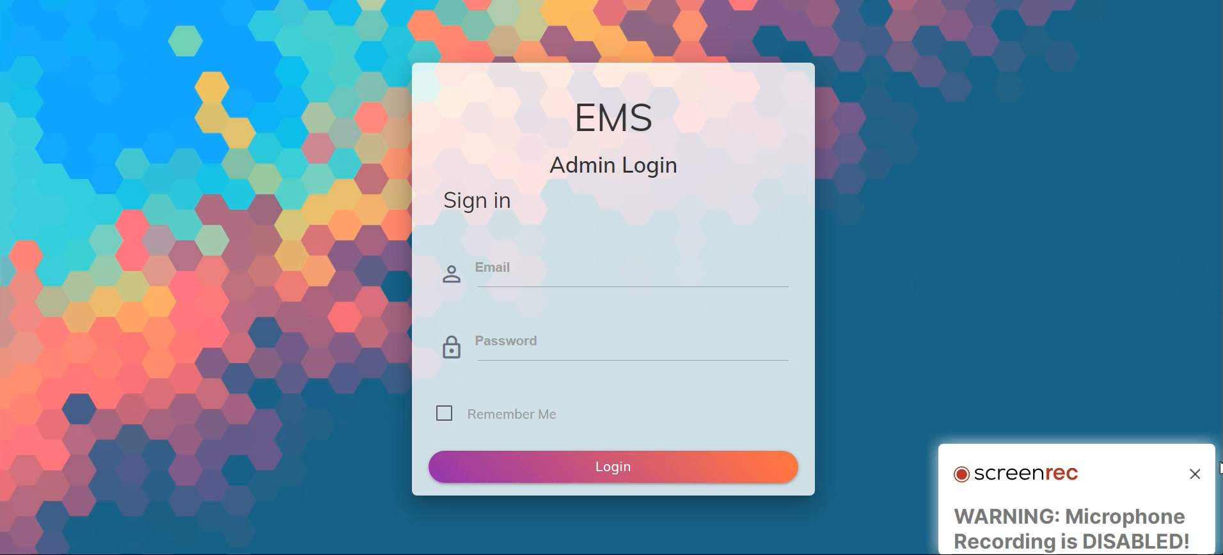

Slide 8
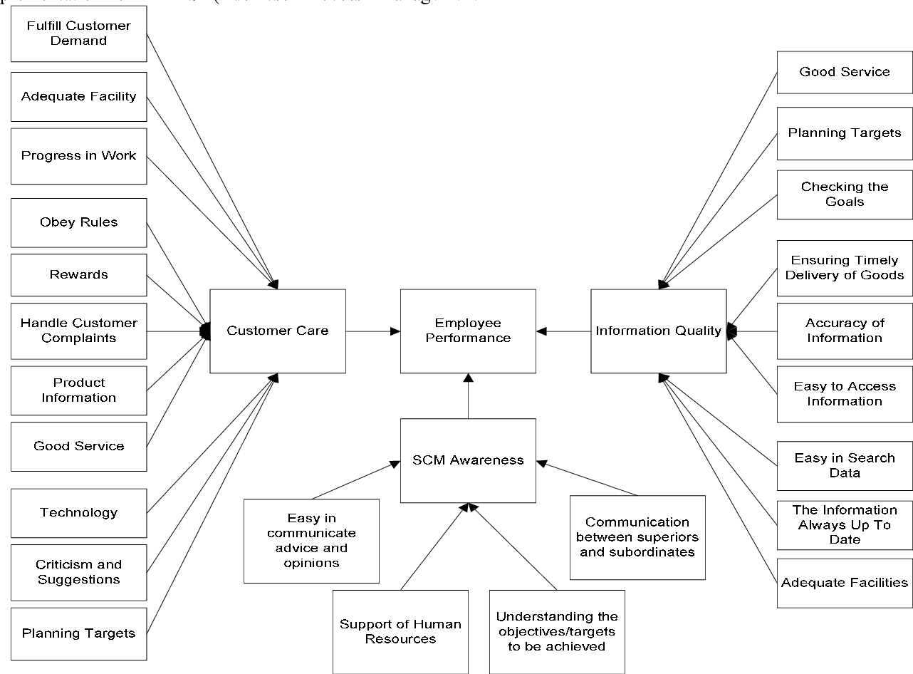
Business model
Create a Web application that manages Employee complete records.
Collaborate with companies to move their manual-based approval to Digitalized application.
Easily Accessible.
Application should be user-Friendly.
Low domain maintenance.
Low Latency & response time.
Responsive design.

Slide 9
Team Contribution:
Jayasri Boppudi & Avinash Reddy Palli: I have contributed in design phase. In this phase I have created prototype and system user interfaces.
Manoj Kumar Bodduluri & Maneesh Chowdary Guntupally : I have contributed in development phase. In this phase I have developed entire system using web technologies.

Slide 10
Thank You

